Slide 1
US Regional Sales Data
Second hand data retrieved from - https://www.kaggle.com/datasets/talhabu/us-regional-sales-data

Slide 2
Preface
This is sales data from an unnamed company in the US. It includes data from June 2018 - December 2020. The company spans across the US and data is included for 367 locations and 28 sales teams. The company sells a large array of products with varying costs ranging between 167$ and 6500$.

Slide 3
Objective
Understand time to ship trends when looking at individual warehouses and over time.
Visualize the relationship between sales and time to ship delays.
Visualize the trends in sales present in the sales data
Visualize which sales channels contribute the most to our sales.
Visualize the relationship between unit cost and sales.
Compare sales team performance in terms of both sales and profits.

Slide 4
Data Dictionary
Dimensions | Measures | Missing Values
OrderNumber: an arbitrary value to differentiate orders SalesChannel: what kind of sale was it (online, in store, dist, wholesale) WarehouseCode: an arbitrary value to differentiate warehouses Procured Date: when the item was received in warehouse OrderDate: the date the order was placed ShipDate: the date the order shipped DeliveryDate: the date the order was delivered CurrencyCode: what currency the sale was _SalesTeamID: an arbitrary value to differentiate sales teams _CustomerID: an arbitrary value to differentiate customers _StoreID: an arbitrary value to differentiate stores _ProductID: an arbitrary value to differentiate products Order Quantity: how many of that item was purchased in that order Discount Applied: percentage of discount to order Unit Cost: the cost of obtaining each product Unit Price: how much the product is being sold for | Any dates are in dd/mm/yyyy format Unit cost and unit price are in USD$ Discount applied is a percentage represented as a decimal | No missing values, but lacking data from months 1-5 for 2018 and limited data for month 6

Slide 5
Warehouses and Time to Ship Trends
Are there large discrepancies in time to ship between warehouses that need to be addressed? Are there certain times of the year where shipping time may be higher/lower? How does shipping time relate to monthly sales?

Slide 6
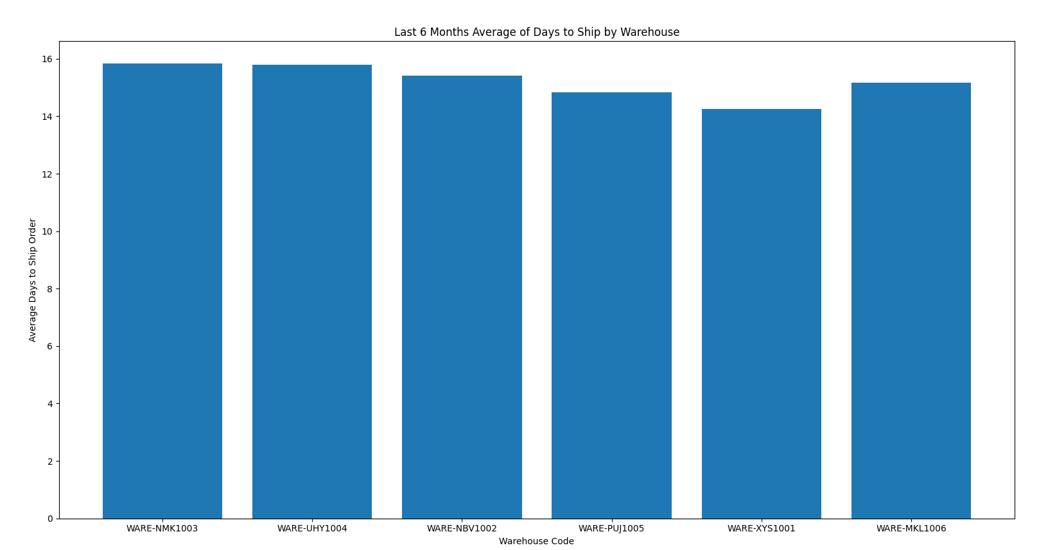
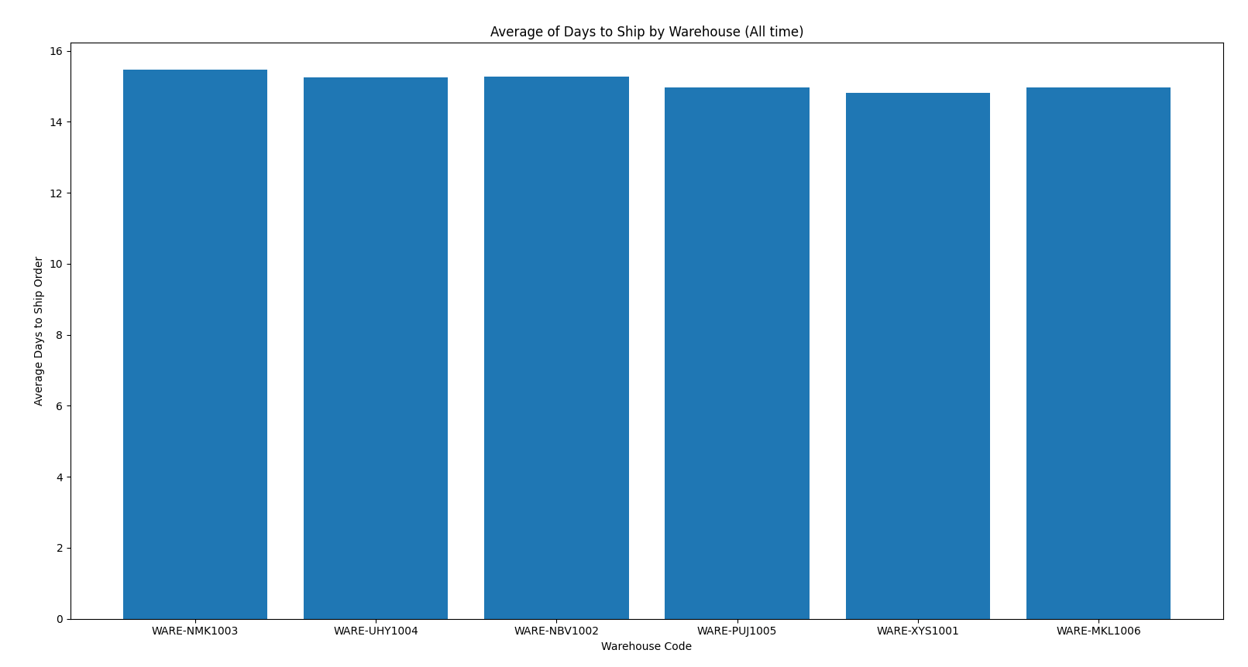
Are there large discrepancies in time to ship between warehouses that need to be addressed?

Slide 7
Insights
Warehouse XYS1001 seems to be performing particularly well recently. Just above 14 days. Look into why, and try to improve the others.
The average all time is very consistent. It is not a warehouse issue but an operations issue.

Slide 8
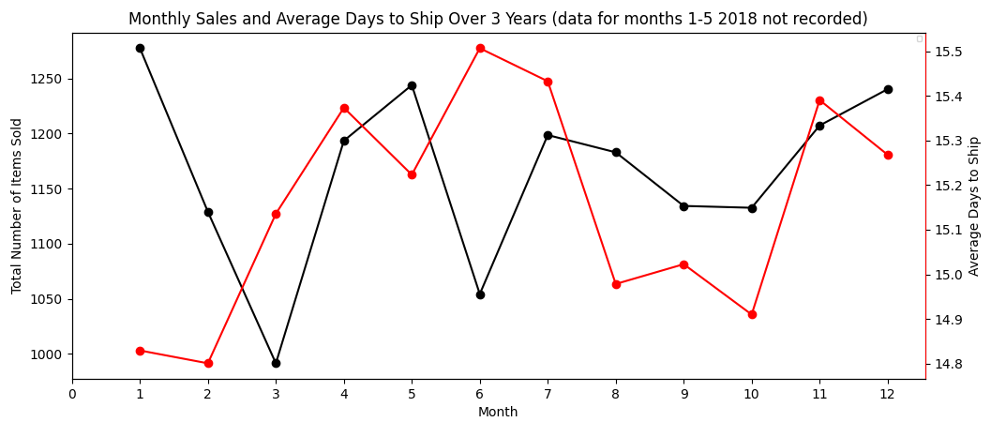
Are there certain times of the year where shipping time may be higher/lower? How does shipping time relate to monthly sales?

Slide 9
Insights
Days to ship closely relates to the number of orders.
Months 4-7 and 11-12 have particularly high days to ship.
January has unusually low days to ship when compared to orders.
June has unusually high days to ship when compared to orders. Vacation time? Rapid or large orders? Certain product that is hard to ship?
Months 1-2 have particularly low days to ship.

Slide 10
Sales Trends
Are there times of the year when sales tend to increase? How do profits look from month to month, year to year? What is the growth of specific sales channels? Which sales channels contribute the most to our sales?

Slide 11
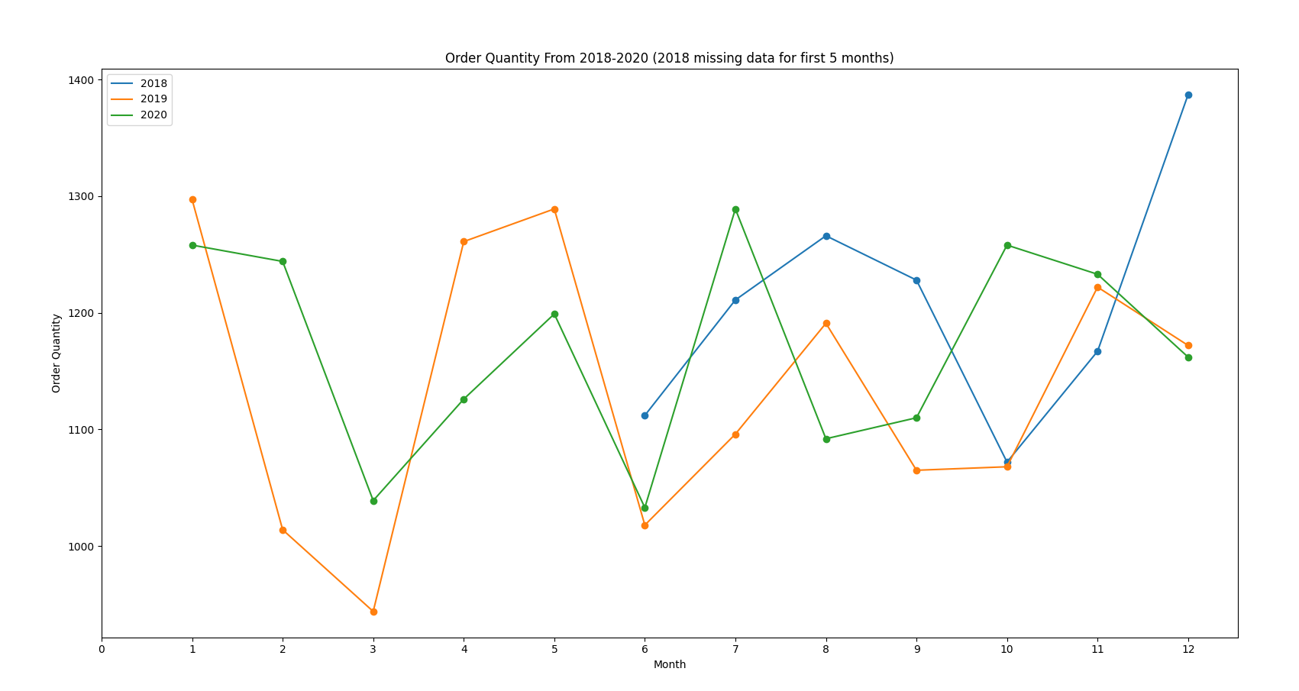
Are there times of the year when sales tend to increase? How do profits look from month to month, year to year?

Slide 12
Insights
Very big dips in March and June. They are both consistent from year to year.
Months July-October seem to be consistent average sales.
Months November-January are big sellers.

Slide 13
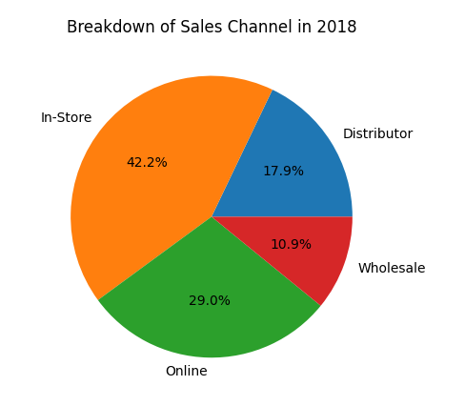
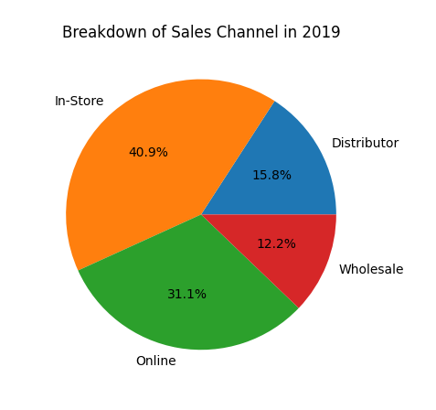
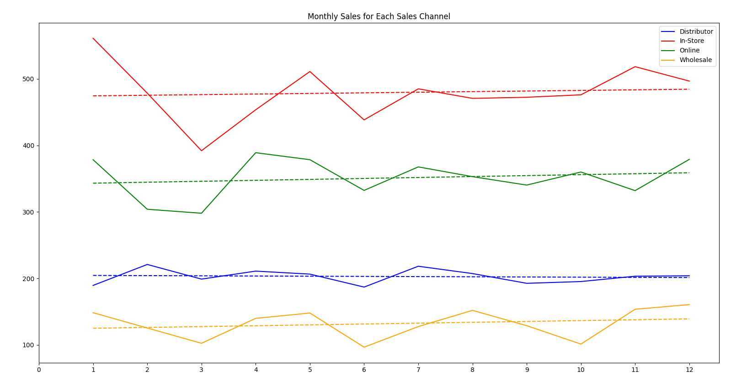
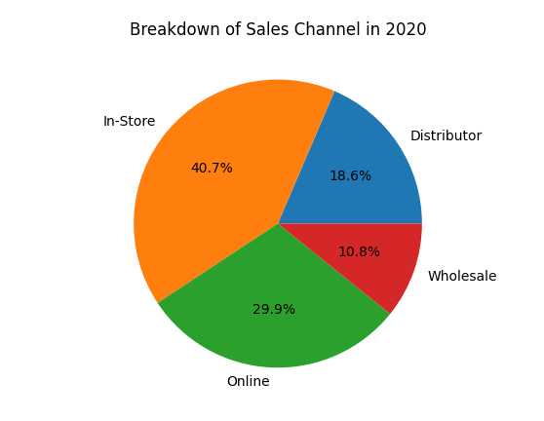
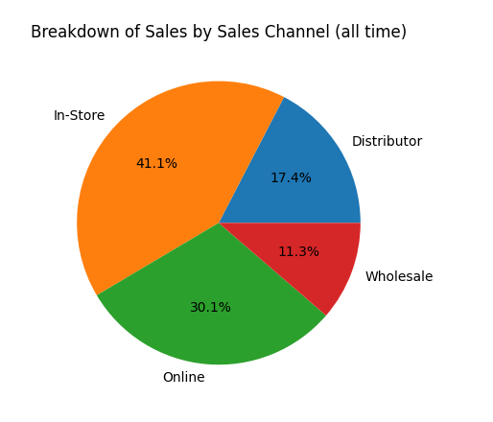
What is the growth of specific sales channels? Which sales channels contribute the most to our sales?

Slide 14
Insights
In store decreased by about 1.5%.
Online increased by about 1.5%.
Wholesale and distributor sales fluctuated slightly but not consistently.
All sales channels followed the same pattern as total sales.
All sales channels see slight increase with months.

Slide 15
Unit Cost Trends
What time of the year are unit costs the highest for our business? How do unit costs affect sales?

Slide 16
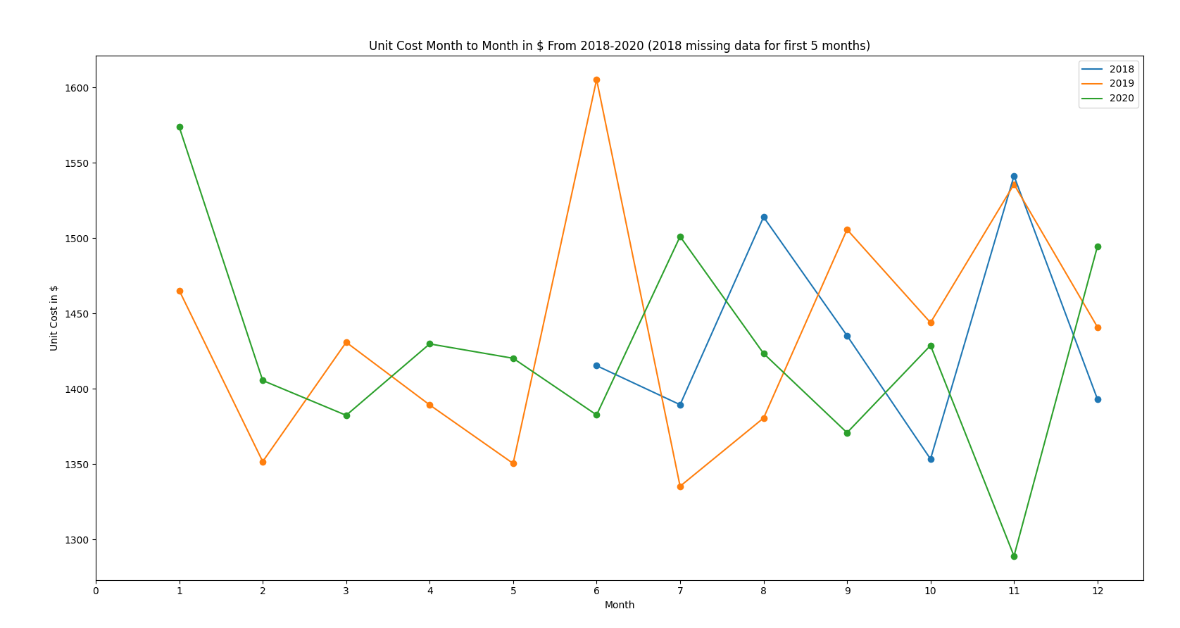
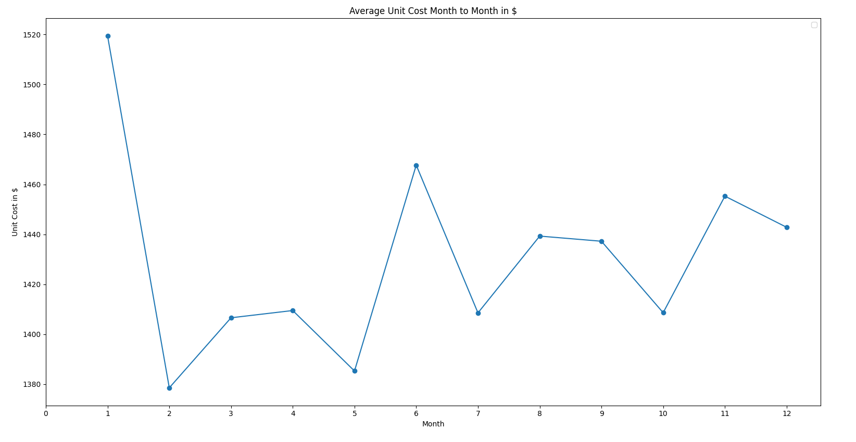
What time of the year are unit costs the highest for our business?

Slide 17
Insights
Unit costs are consistent around Jan-June.
Unit costs are very inconsistent around July-Dec.
There is a huge spike in unit costs for June 2019 that seem to skew the data.

Slide 18
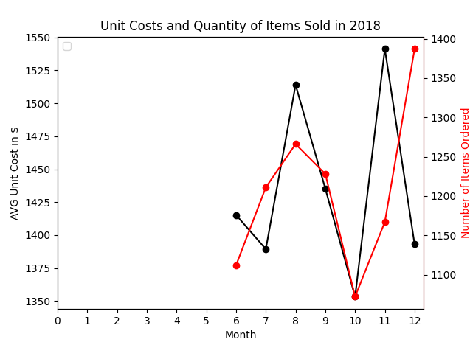
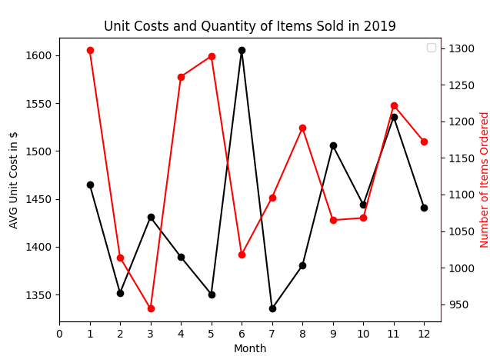
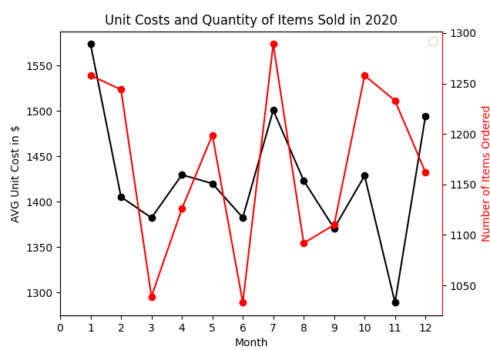
How do unit costs affect sales?

Slide 19
Insights
Unit costs are a surprisingly effective predictor of total items sold.
Rather than decreasing sales when unit costs increase, we see see a matching increase.
Unit cost increases must not come from shortages or supply issues, but rather primarily from demand.
The trend isn’t perfect. A few spikes with dips but generally fairly similar.

Slide 20
Sales Teams Performance
Which sales teams bring in the most profit? Which sales teams make the most sales? In general which teams seem to be performing best?

Slide 21
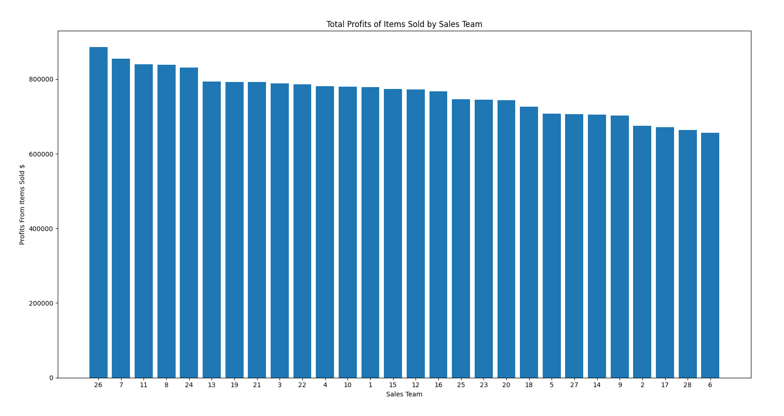
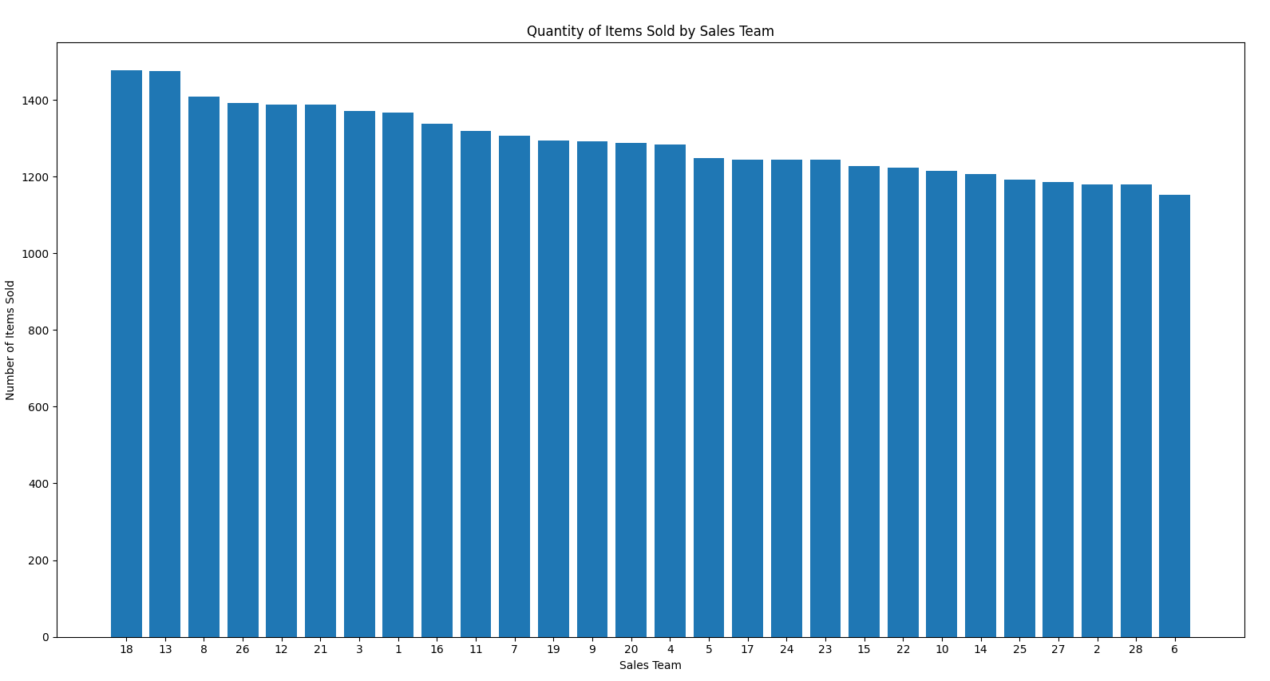
Which sales teams bring in the most profit? Which sales teams make the most sales? In general which teams seem to be performing best?

Slide 22
Insights
Teams 18, 13, 8, 26, and 12 make the most sales.
Teams 26, 7,11, 8, and 24 make the most profit on items sold.
Teams 8, 26, and 13 seem to be our best performers.
Team 12 is #5 in sales but middle of the pack in profit on sales.

